Slide 1
Harvard University Herbarium Handwriting Transcription
Shubhangi Jain

Slide 2
Objective
To transcribe handwritten text on images of herbarium specimens.
Herbarium specimens are pressed plant samples stored on paper.
Each specimen contains a label that contains the name of the curator, their institution, the species and genus, and the collection date.
A sizable number of these labels are handwritten and date back to the early 1900s.

Slide 3
Dataset

Slide 4
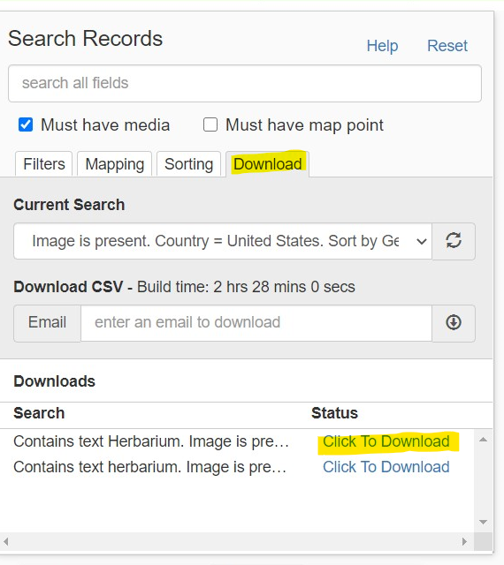
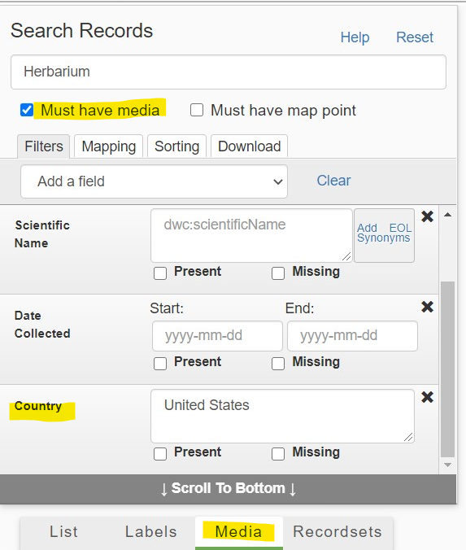
iDigBio
Millions of data and images of biological specimens are available here, funded by National Science Foundation

Slide 5
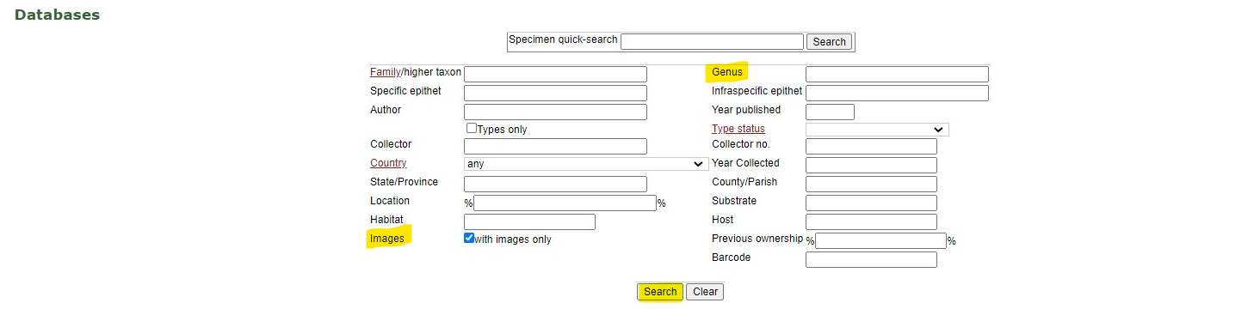
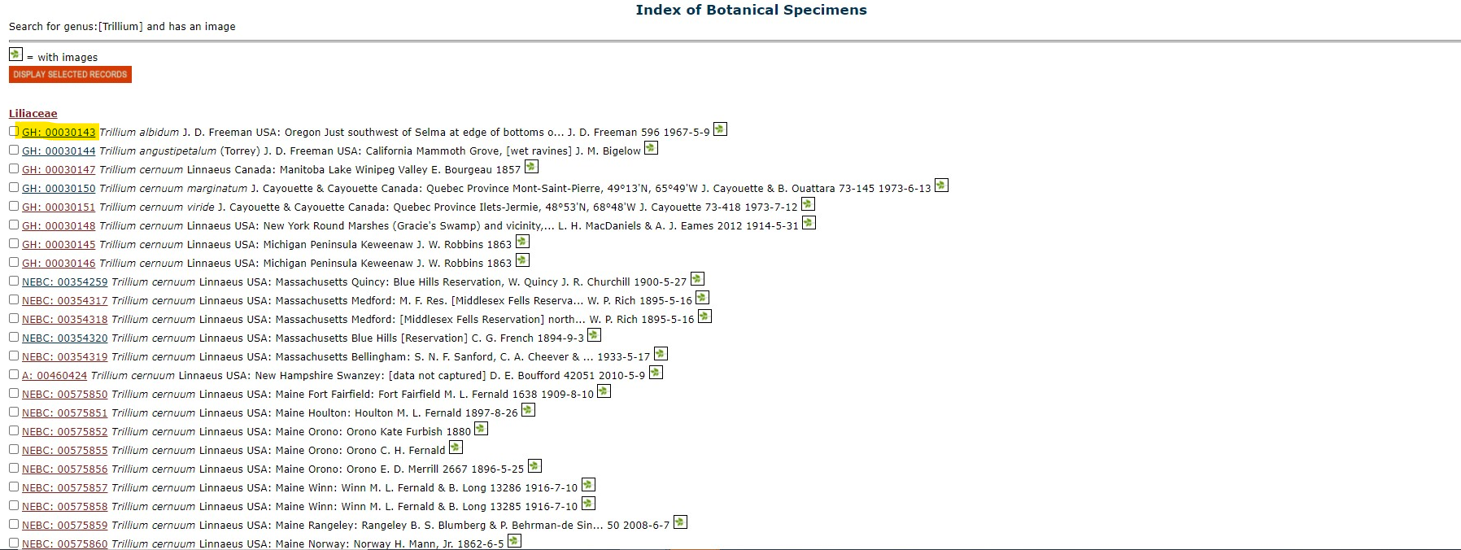
Harvard University Herbaria & Libraries

Slide 6
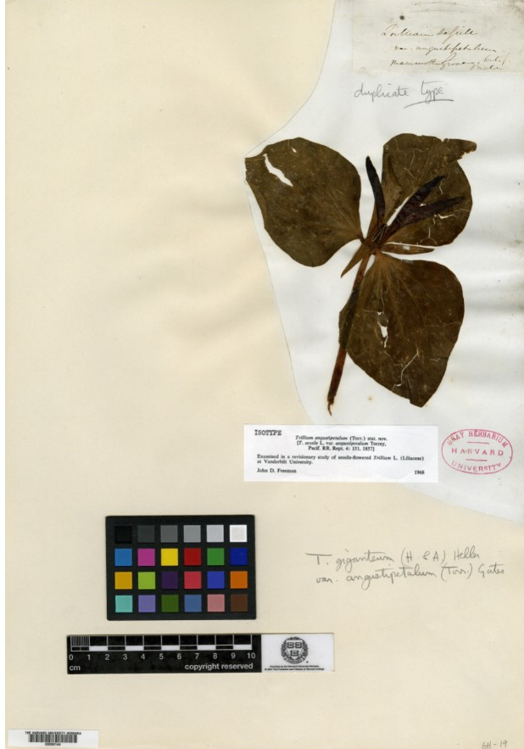
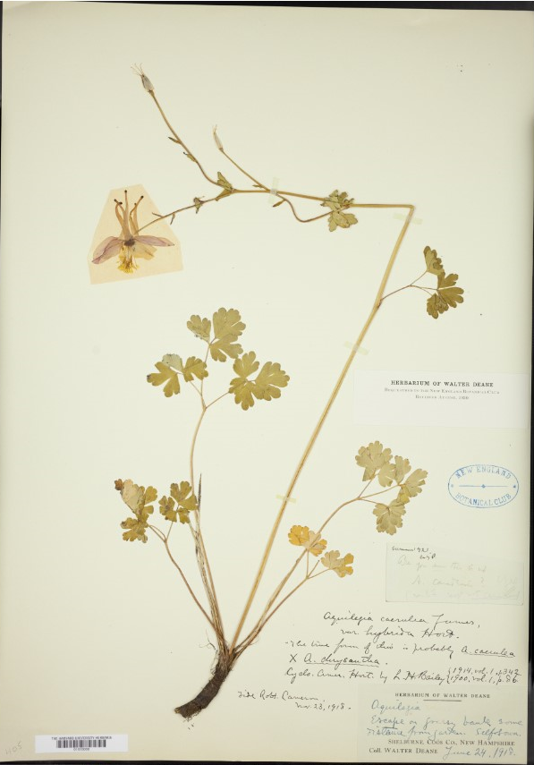

Slide 7
Initial Insights
Total images:
Aquilegia: 1201
Trillium: 924
All labels are in English
No specific location of labels in the image

Slide 8
Hypothesis: All images have labels
Created bounding box around the text: EAST text detector*
* https://github.com/ZER-0-NE/EAST-Detector-for-text-detection-using-OpenCV

Slide 9
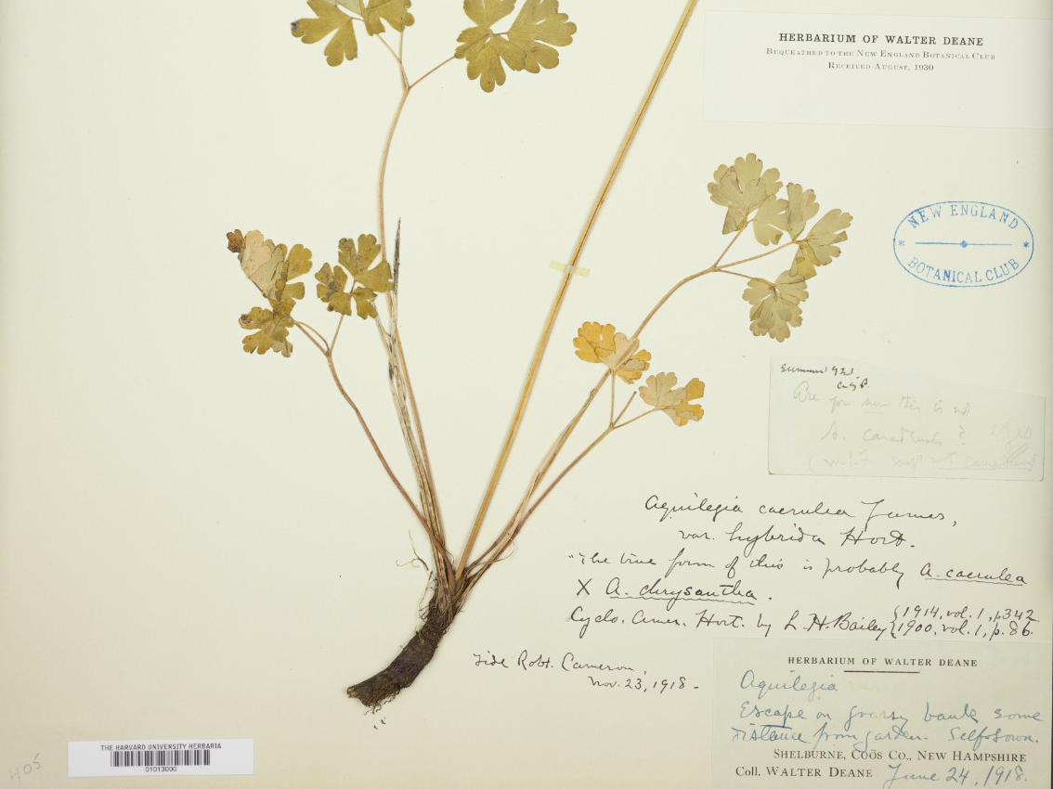
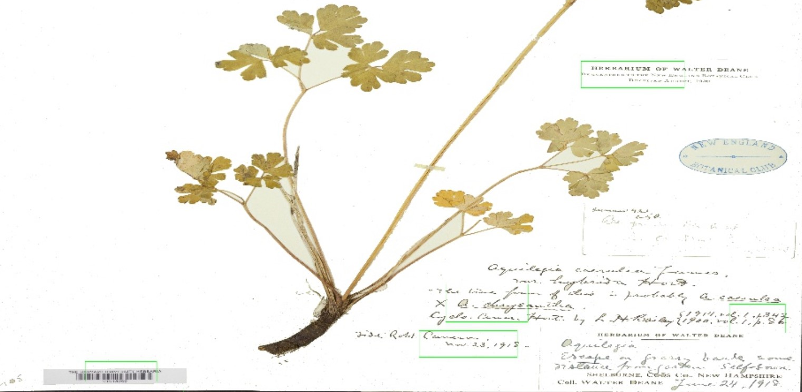

Slide 10
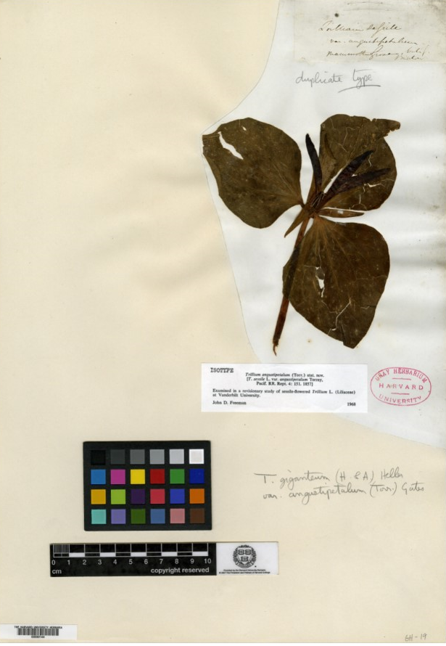
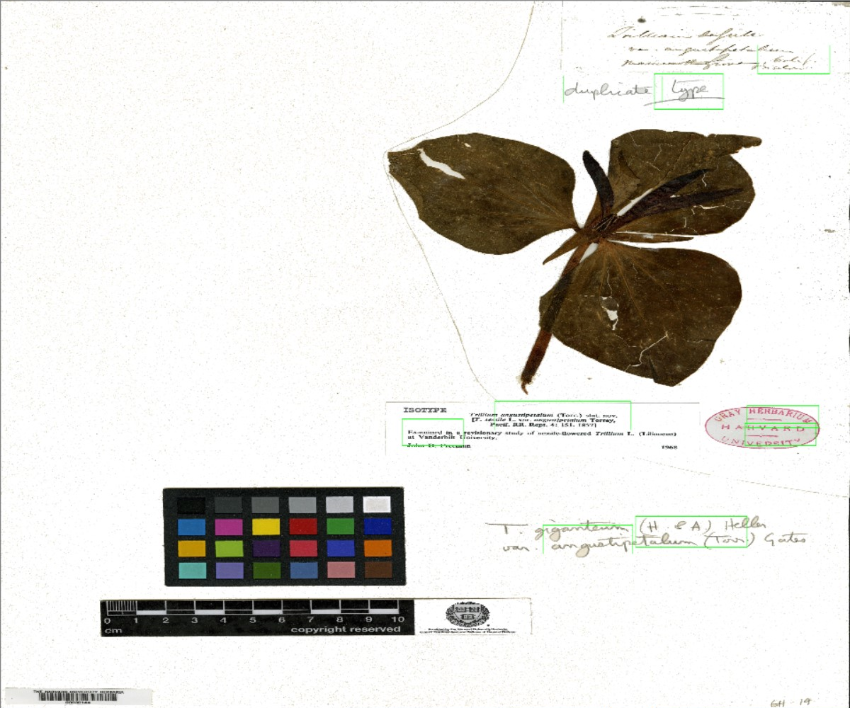

Slide 11
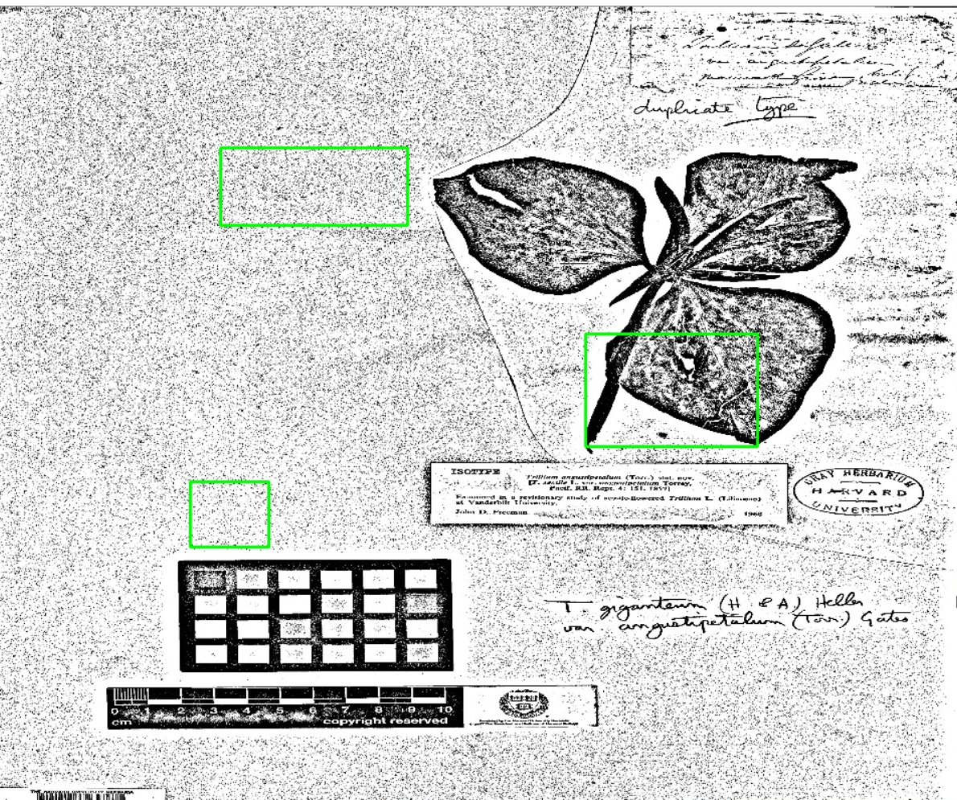
Notes:
Kernel size impact

Slide 12
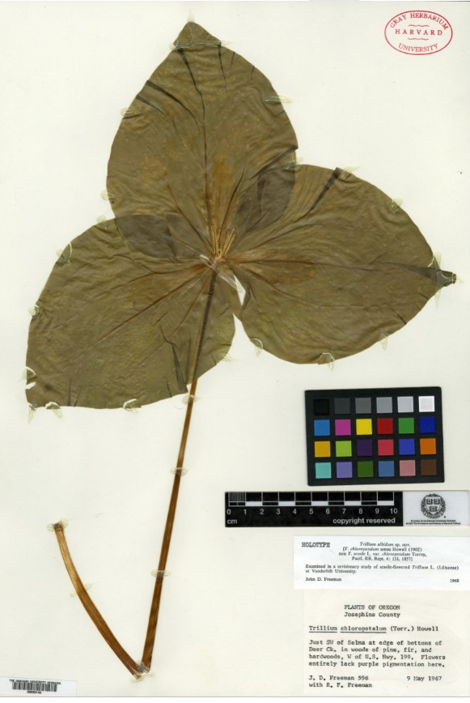
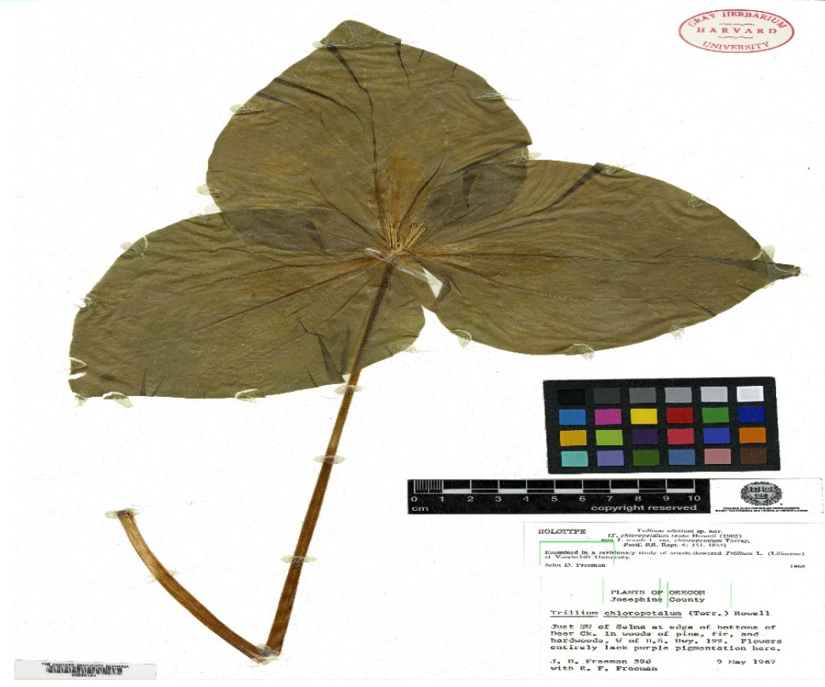

Slide 13
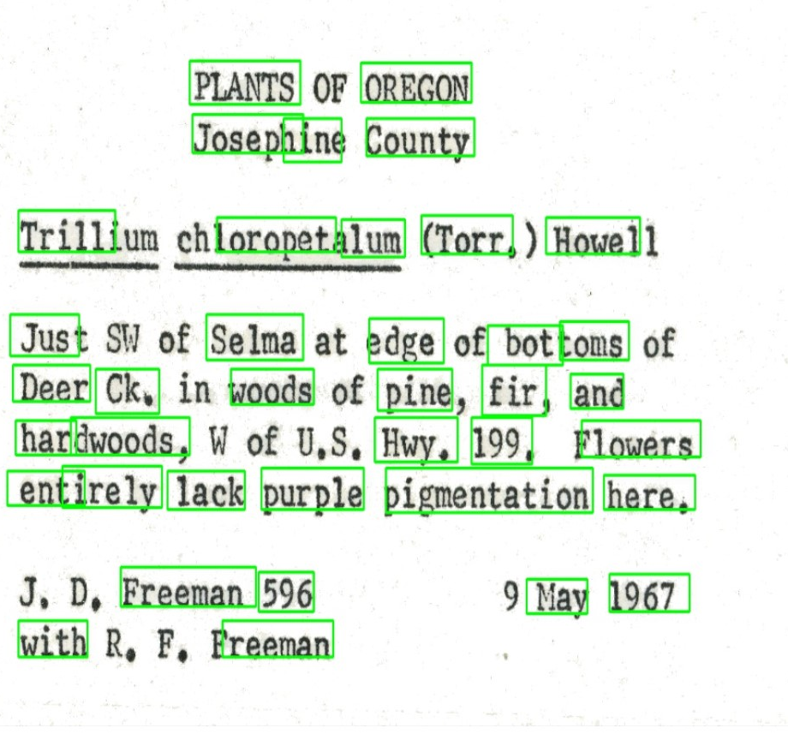
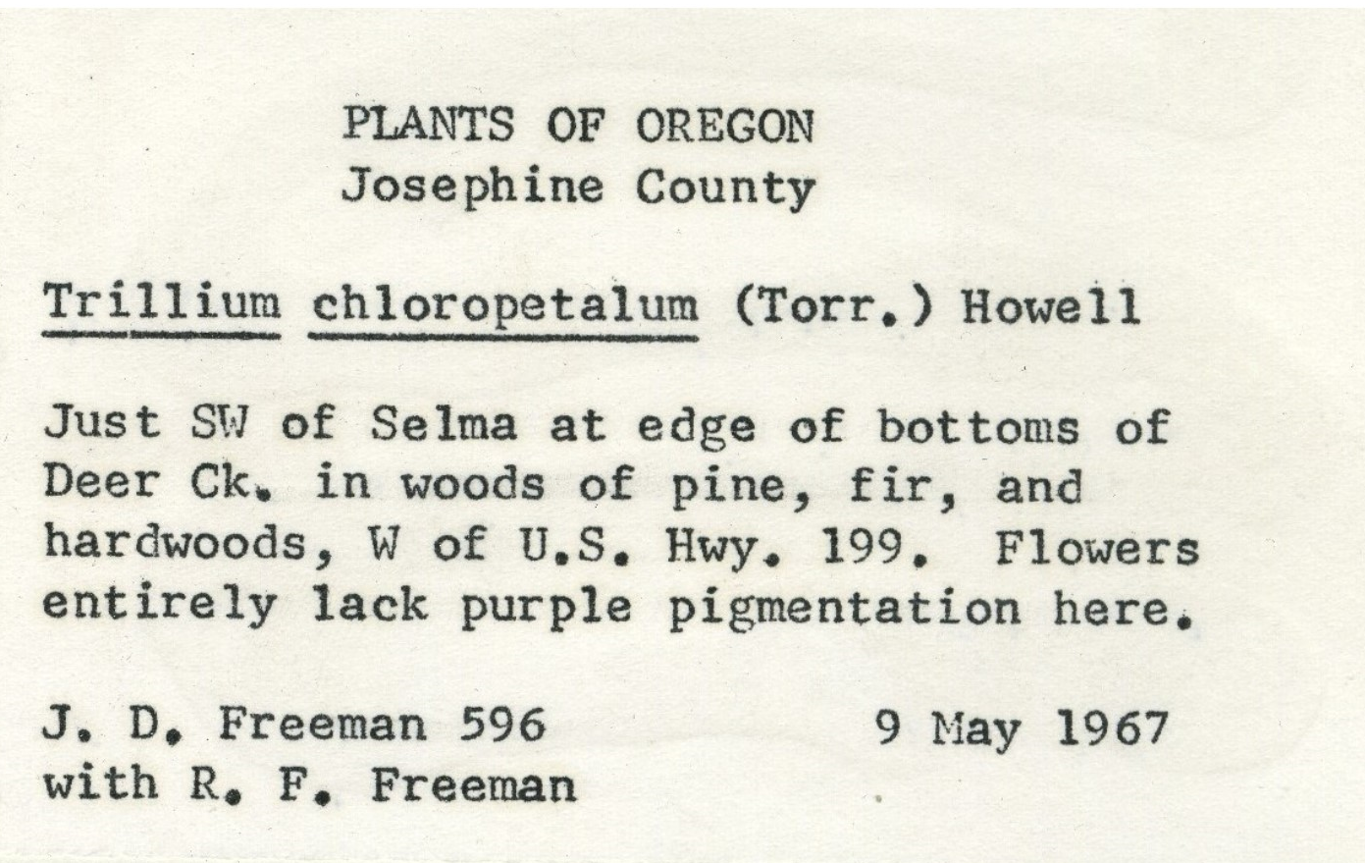

Slide 14
Labels of the dataset

Slide 15
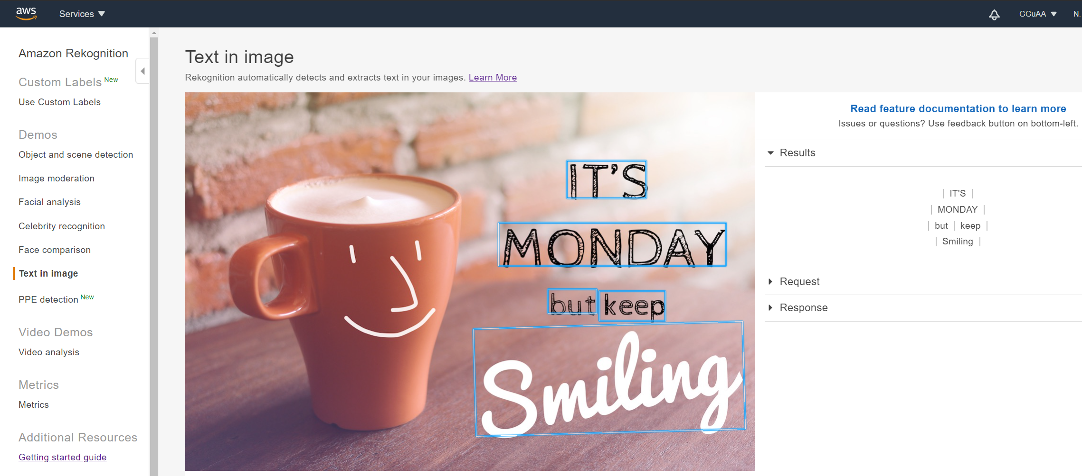
Transcription

Slide 16
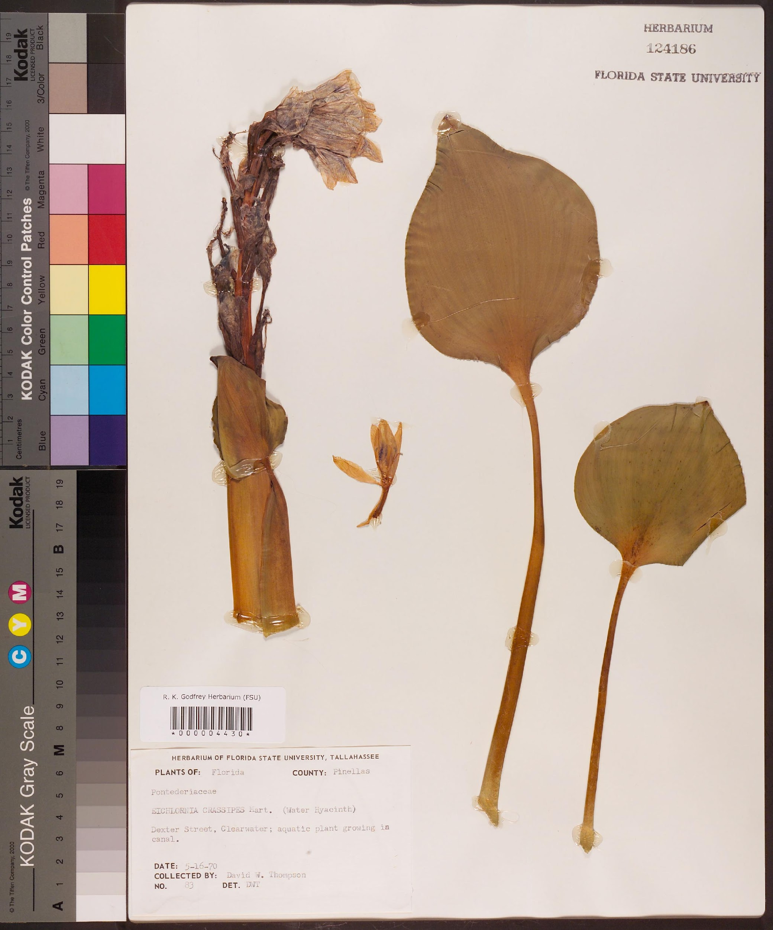
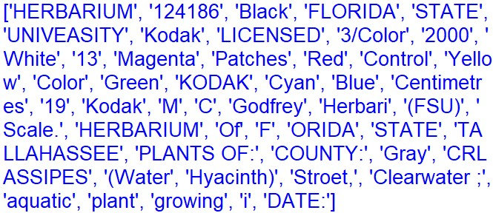

Slide 17
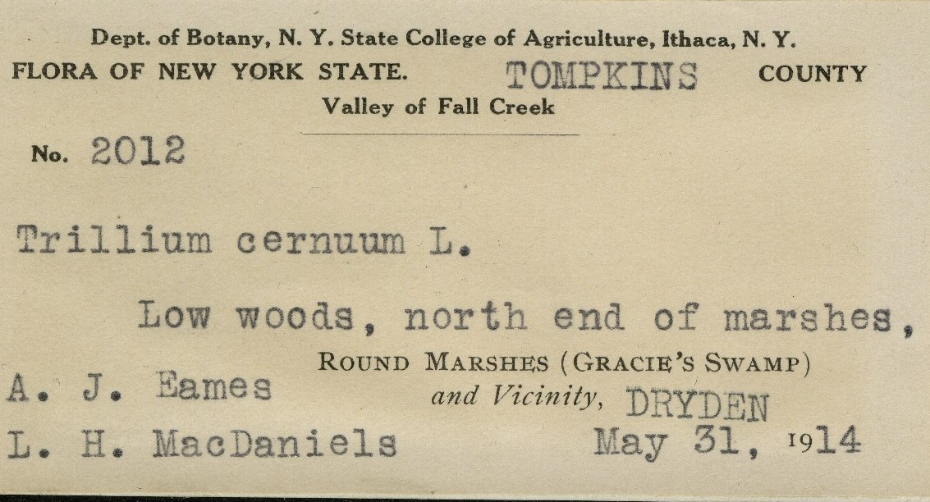
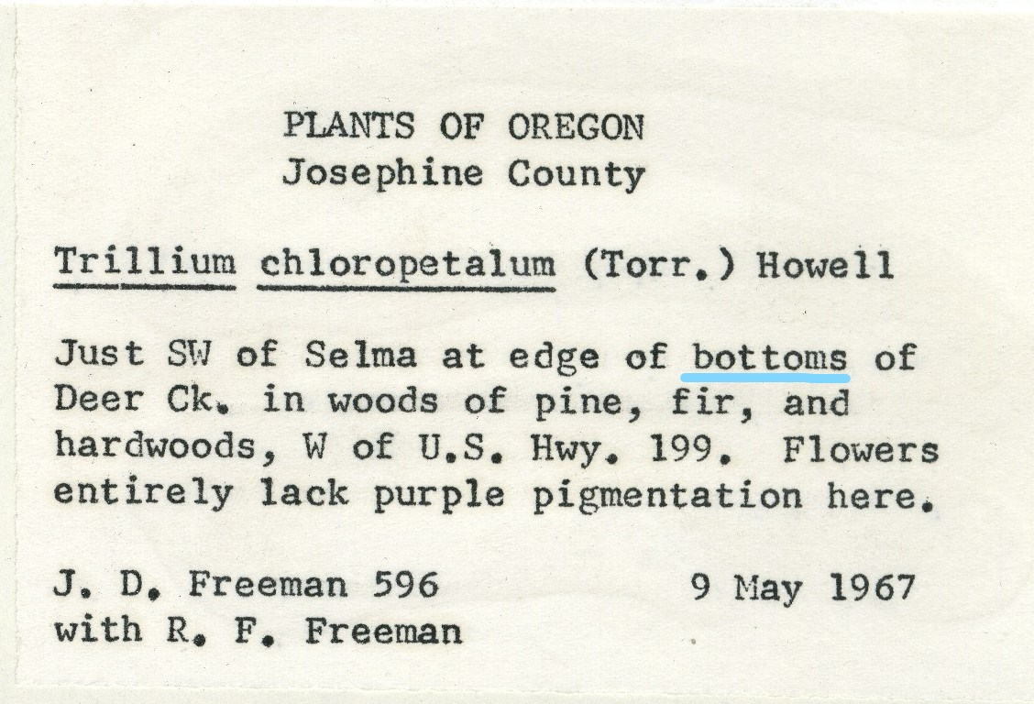
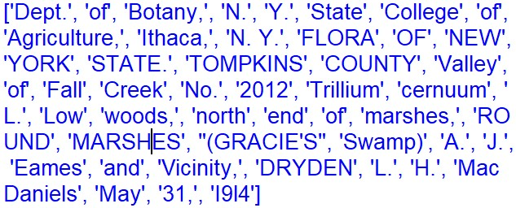
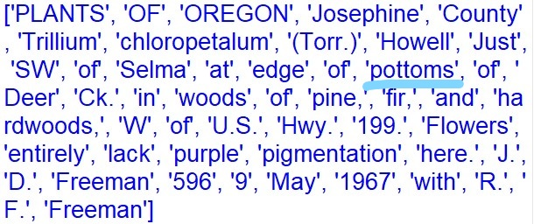

Slide 18
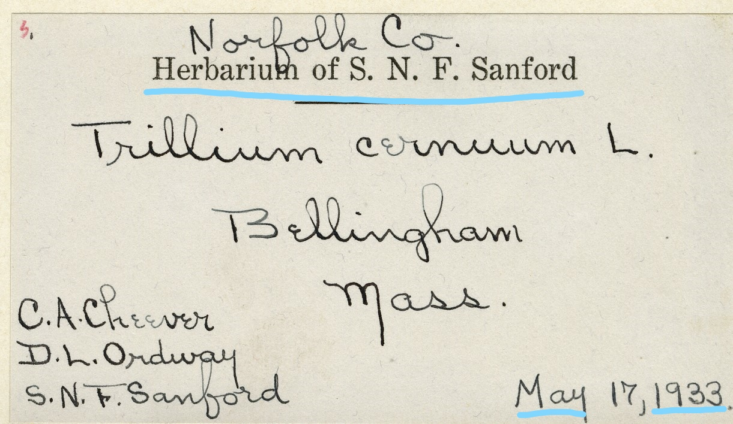
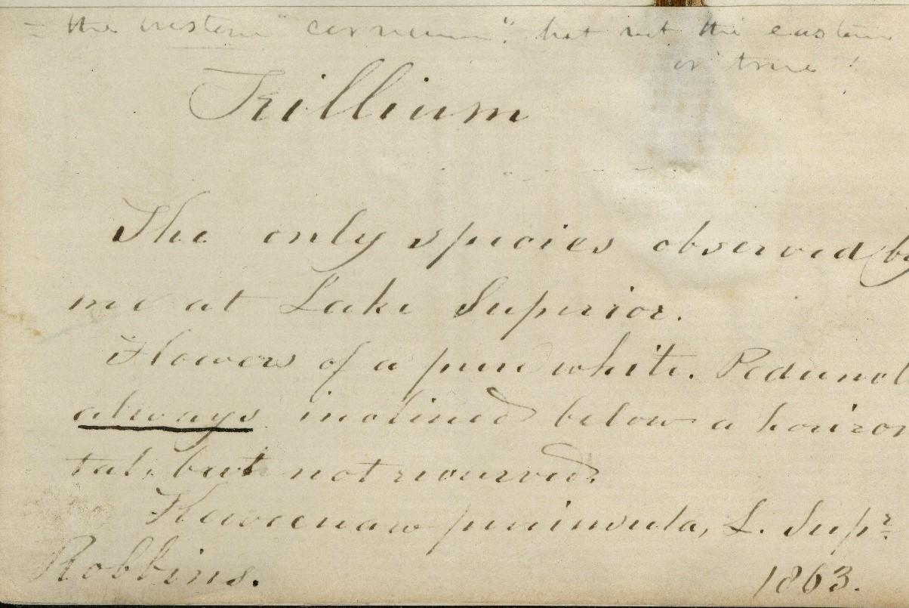
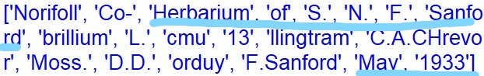
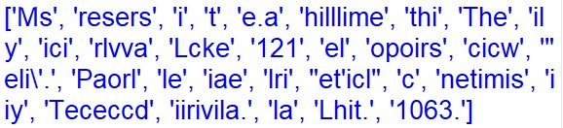

Slide 19
Questions?

